Slide 1
Abstract
The Tournament Fixer project is a web-based application that allows users to create and manage tournament brackets for different sports. It enables users to select a sport, enter the number of teams, input team names, and generate random match fixtures with a clear visual flow chart. The system provides interactive match selection and stores data through a backend API.

Slide 2
Existing System
Existing systems for tournament management are often static, manual, or limited to specific games. They require manual input and do not dynamically generate brackets or support random team selection, leading to inefficiency and lack of automation.

Slide 3
Proposed System
The proposed Tournament Fixer system automates the entire match generation process. Users can choose any game, enter team names, and generate randomized fixtures dynamically. The frontend visualizes match progression, and the backend handles data saving and retrieval seamlessly.

Slide 4
Advantages
• Dynamic random fixture generation
• Supports multiple sports
• Interactive and user-friendly interface
• Data persistence via backend API
• Eliminates manual scheduling errors

Slide 5
Disadvantages
• Requires internet/browser access
• No database integration (JSON-based only)
• Limited to knockout-style tournaments

Slide 6
Hardware Requirements
• Processor: Intel Core i3 or higher
• RAM: Minimum 4GB
• Hard Disk: 500MB free space
• Display: 1024x768 resolution or higher

Slide 7
Software Requirements
• Operating System: Windows / macOS / Linux
• Frontend: HTML, CSS, JavaScript
• Backend: Java Spring Boot, Maven
• Browser: Chrome / Edge
• IDE: VS Code & IntelliJ IDEA

Slide 8
Modules
1. User Input Module
2. Bracket Generation Module
3. Randomization Module
4. Match Progression Module
5. JSON Export Module
6. Backend API Module

Slide 9
Module Description
• User Input Module – Allows users to choose sport and number of teams.
• Bracket Generation Module – Dynamically creates tournament flow.
• Randomization Module – Randomly assigns teams for fairness.
• Match Progression Module – Lets users select winners to move forward.
• JSON Export Module – Saves tournament results.
• Backend API Module – Handles data transfer using REST API.

Slide 10
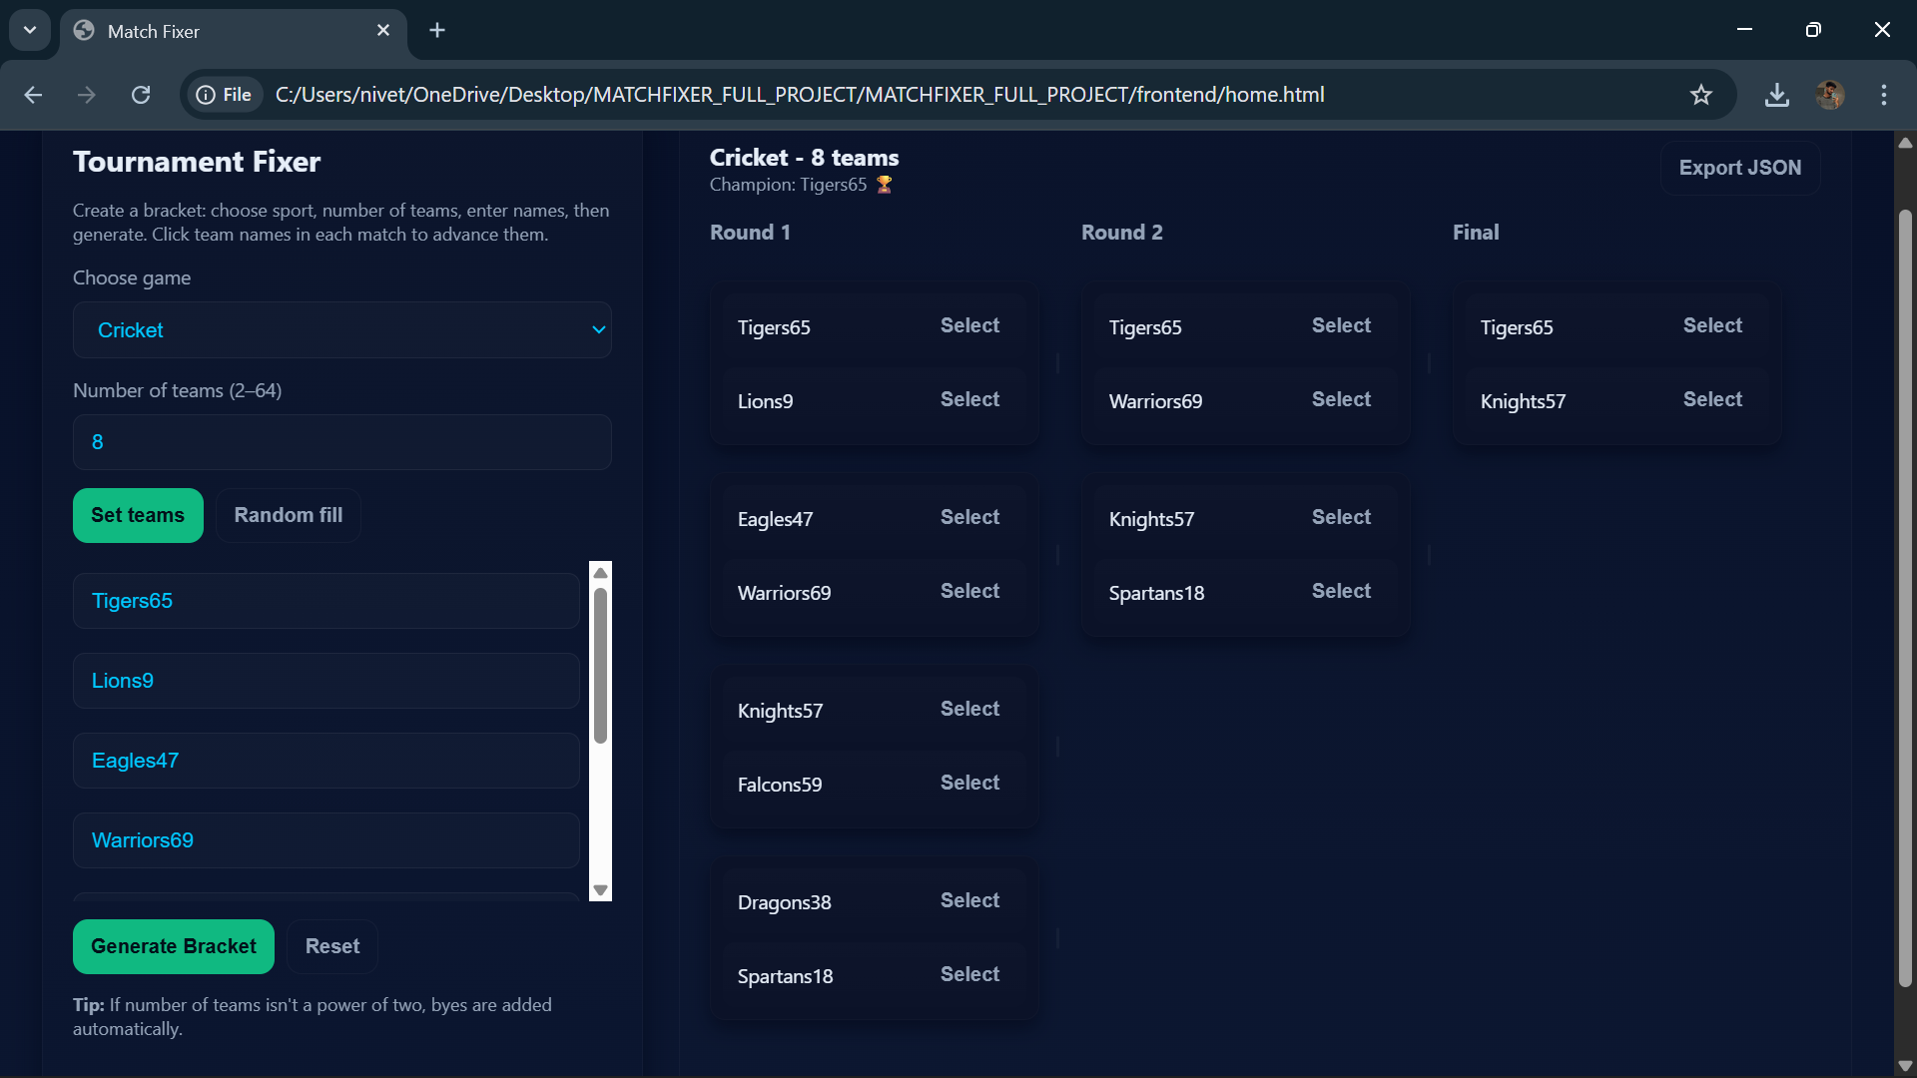
Sample Output

Slide 11
Conclusion
The Tournament Fixer project successfully automates tournament management, enhancing usability, efficiency, and accuracy. It provides a simple yet powerful platform for organizing sports events digitally with dynamic fixtures and interactive UI.

